Slide 1
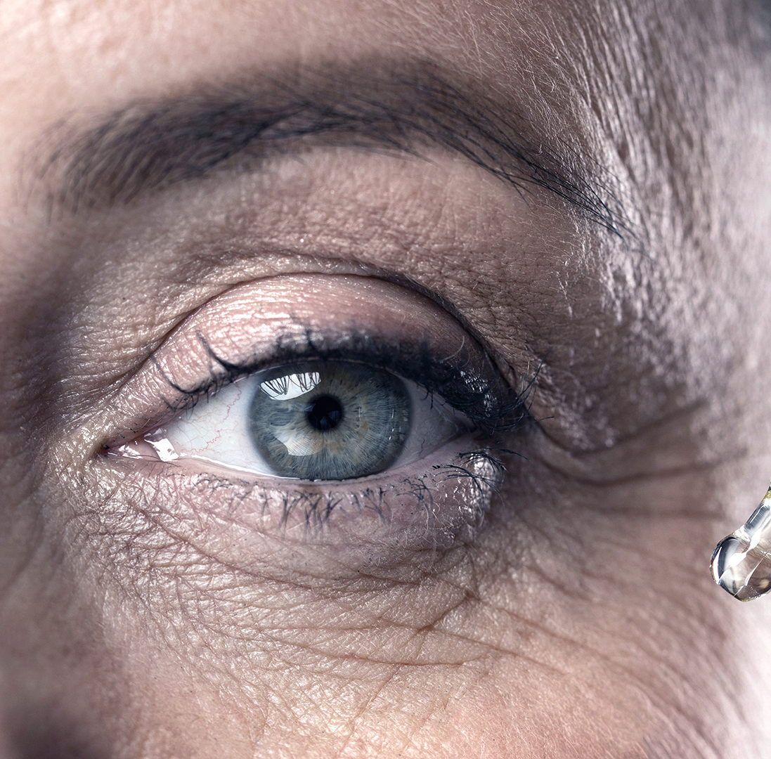
Diagnosis of retinal disorders from OCT

Slide 2
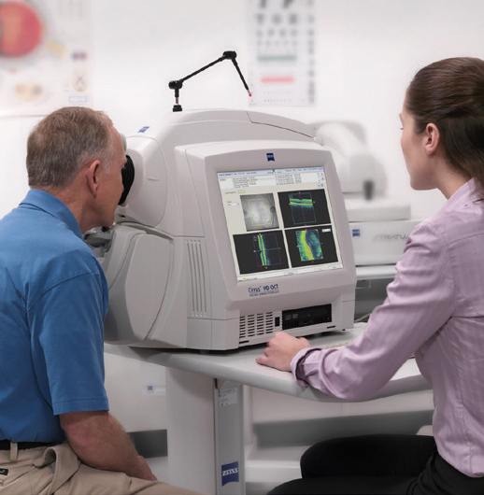
Introduction
Retinal optical coherence tomography (OCT) is an imaging technique used for the diagnosis of retinal and vitreous disease.
OCT captures high-resolution cross sectional image of the anterior eye.
It is a noncontact imaging system.

Slide 3
Introduction
30,000,000
Approximately 30 million OCT scans are performed each year

Slide 4
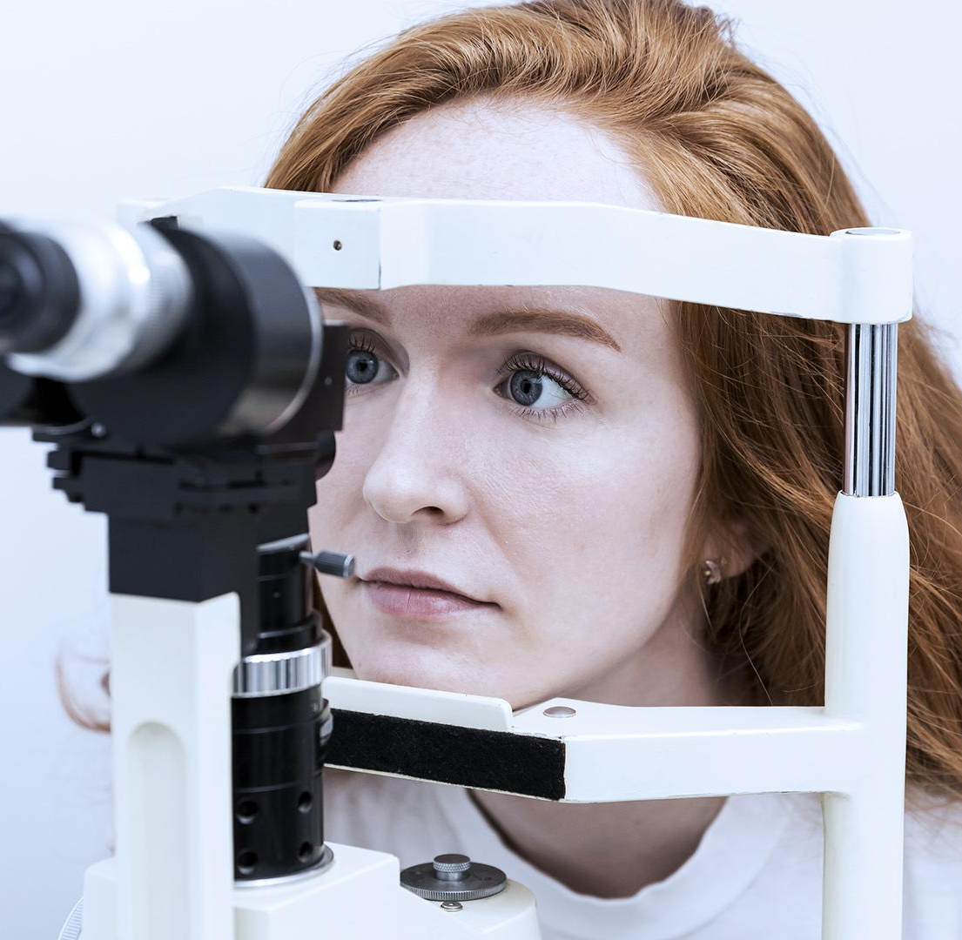
Problem Statement
Retinal diseases are the most common cause of losing eyesight at an early age
OCT helps patients prevent or minimize vision loss by detecting retinal diseases in the early stages of treatment
Using the traditional approaches it takes a considerable amount of time to analyse and interpret the OCT images.
Different kinds of retinal disease are:
CNV
DME
Drusen

Slide 5
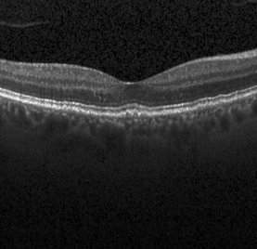
Normal OCT

Slide 6
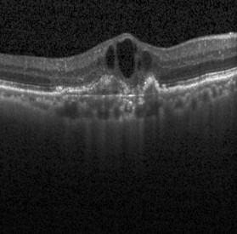
CNV
New blood vessels created in the eye is known as Choroidal neovascularization (CNV).
It is the main cause of losing central vision, a vision which processes the light changes into
nerve signals to inform the brain what the person is seeing.
The break in the membrane can be seen as a hollow space in the retinal OCT x-ray
Choroidal neovascularization

Slide 7
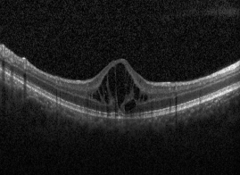
DME
Diabetic macular edema (DME) is a complication of diabetes.
Fluid accumulation in the retina’s macula due to leaking blood vessels is the cause of DME.
In the OCT scanned image defect in fovea can be seen as small holes in the membrane
It causes blurred vision, wavy vision, double vision, a sudden change in eye floaters, and faulty perception of colors.
Diabetic macular edema

Slide 8
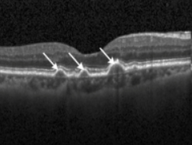
Drusen
Drusen are small accumulations of yellow or white extracellular material. They are like tiny pebbles of debris.
Drusen is associated with aging and macular degeneration which causes central vision loss.

Slide 9
Objective
Retinal disease classification is a significant problem in computer-aided diagnosis (CAD) for medical applications.
In this research, we have tried to detect retinal diseases from optical coherence tomography (OCT) X-ray images.
We propose a classification algorithm based on deep learning to detect retinal diseases from OCT images and identify three conditions of the retina.

Slide 10
Expected Goal
The proposed approach has a potential impact on creating a tool for automatically detecting retinal diseases from the given OCT scan

Slide 11
Workflow
Data
Collection
Data Ingestion
Data
Pre-Processing
Model Evaluation
Model Training
Making CNN model
Model Deployment

Slide 12
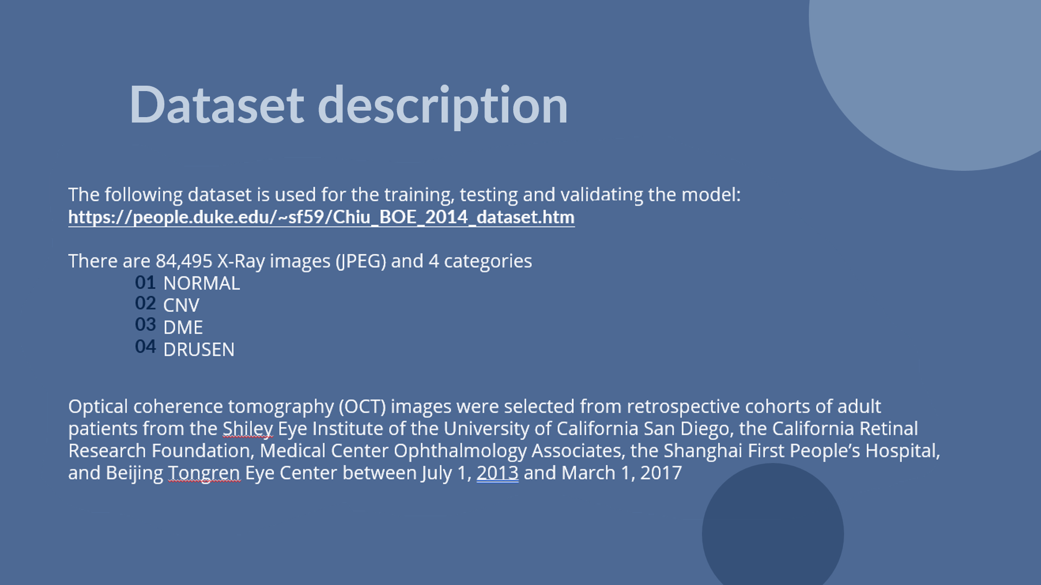

Slide 13
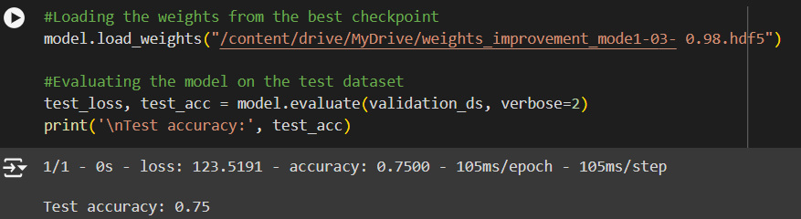
Evaluating the model

Slide 14
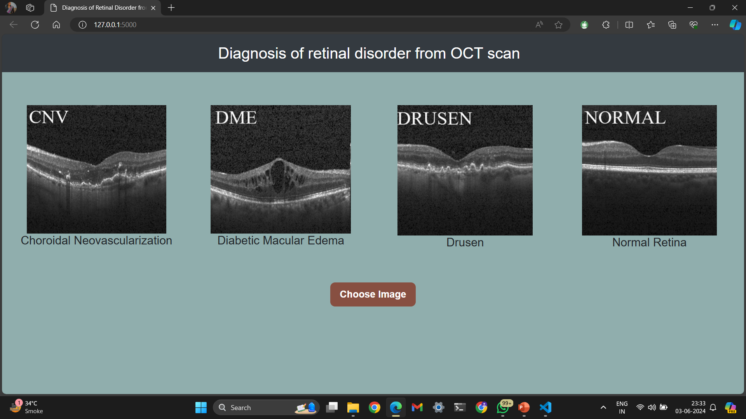
Model deployment
Lastly, we deployed our model locally and globally as well

Slide 15
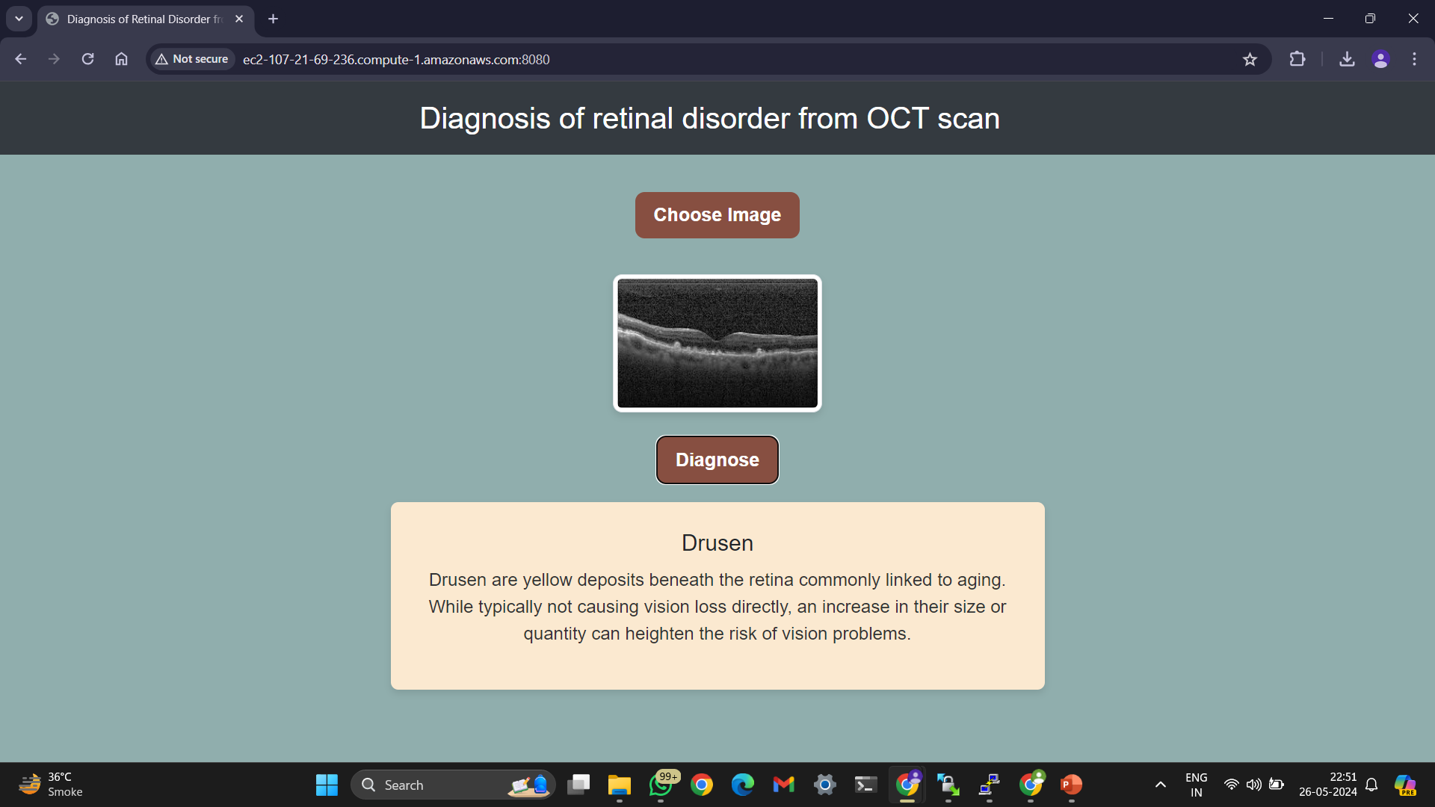
Model deployment
Predicted outcome on globally hosted website

Slide 16

Thank You :)

